Slide 1
CS 461 Introduction to AI Basis and Concepts

Slide 2
What is AI?
Does it involve thought? Behavior? To what standard?
Acting humanly
Turing test: Can an AI system communicating via text interface mimic a human well enough to convince someone that it’s human?
General knowledge, natural language processing, social cues
Acting Rationally
Can a system integrate information about its environment and formulate a plan of action?
Sensing, reasoning in the presence of uncertain or incomplete information, identifying costs & tradeoffs
Thinking humanly
Identifying “laws of thought” and human reasoning processes
Logic, sensing, learning via same mechanisms as humans use
Thinking rationally
Logic, perception, drawing conclusions & new facts from known ones (learning)

Slide 3
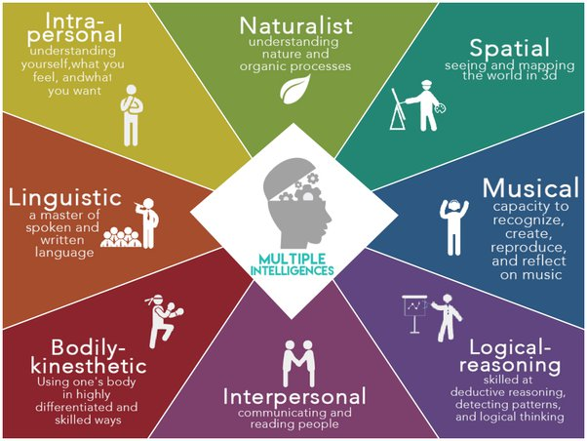
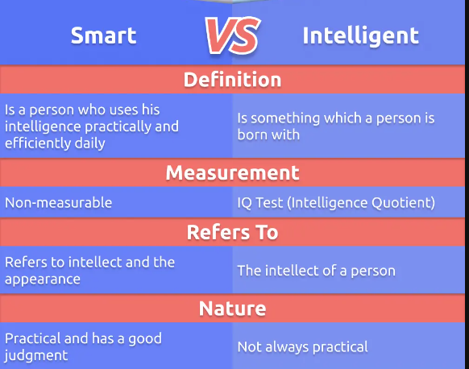
What is AI?
How do we determine if someone (or something) is intelligent?

Slide 4
What is AI?
Is it important that it use the same methods humans use?
What if humans can’t really describe in depth how they reach a conclusion?
What if animal intelligence only emerges in groups?
Individual ants don’t show signs of intelligence, but ant colonies demonstrate coordinated actions
Working definition: Artificial Intelligence is the science of making machines do things that would require intelligence if done by humans
Implications of more complex design?
“A year spent in Artificial Intelligence is enough to make one believe in God.” –Alan Perlis, Epigrams on Programming

Slide 5
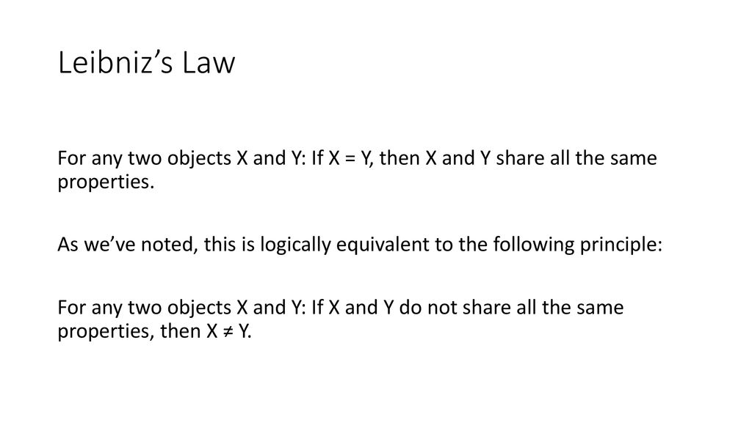
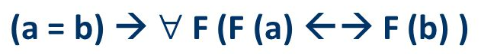
Identity

Slide 6
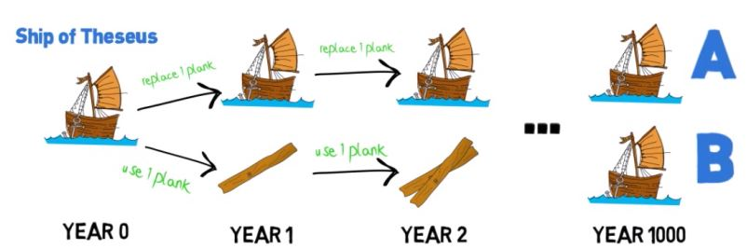
Identity

Slide 7

The Turing Test
Turing proposed an imitation game.
An interrogator interacts with 2 entities—1 human, 1 machine—via text interface
The human is assumed truthful; the machine can lie
The interrogator must determine which is human and which is the machine
So, for example, if asked for the square root of 23,921, the machine would not reply with the answer correct to 12 decimal places within microseconds, as humans don’t do that; it might delay its answer, give an approximation, or make small errors
If asked to discuss today’s weather (because the computer can’t look out the window), the computer can perhaps look up the weather on the Web before responding
If asked about something emotional (“Tell me about your first romantic crush”), the machine would not have direct experience, but would know how humans have described these things; also, emotional depth isn’t synonymous with intelligence

Slide 8
Objections to the Turing test
The head in the sand objection: Intelligent machines would depose us, and thus are too horrible to think about
Not really a serious objection…
Machines don’t have souls and thus can’t be “really” intelligent
We don’t know what the limits are to what can and can’t have souls; also, if the soul is by definition immaterial and immeasurable, how can we know for sure if it’s there or not, i.e. how do we know that we have souls?
A machine can’t do something truly, surprisingly original
Machines have already surprised us with their capabilities.
This assumes that humans can immediately deduce all consequences of a given fact or action; this simply isn’t true
A machine will never, for example, make a human fall in love with it.
But we know how to make objects people come to love. Ever own a teddy bear?
Also, people have fallen in love with (and ‘married’) video game characters
Or appreciate beauty…
That’s your definition of intelligence? Aesthetic appreciation?

Slide 9
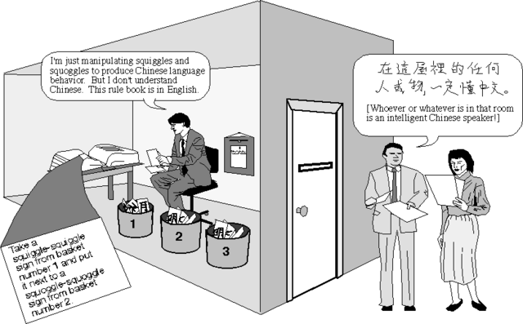
More basic objections to the Turing test
Searle’s Chinese Room: Users pass notes written in Chinese under a door. Inside, a human, who does not know Chinese, looks them up in a series of complex rulebooks and writes out some other symbols (which he also does not understand) and passes them back out under the door. People reading those responses on the other side believe he is answering in Chinese; yet neither the person nor the rulebooks can be said to understand Chinese.
Same setup, with 1000 users, each with their own rulebook, either what output to produce, or who to pass their note to. Again, where does the so-called “knowledge of Chinese” reside?
These rely on the idea that we cannot deduce internal state purely from observing external behavior of a black box; but we know from some situations that we can
Consider a person who does know Chinese. The knowledge of Chinese can’t be localized to a particular part of the brain or set of neurons.
There are parts of the brain that process language, but English and Chinese use the same parts of the brain

Slide 10
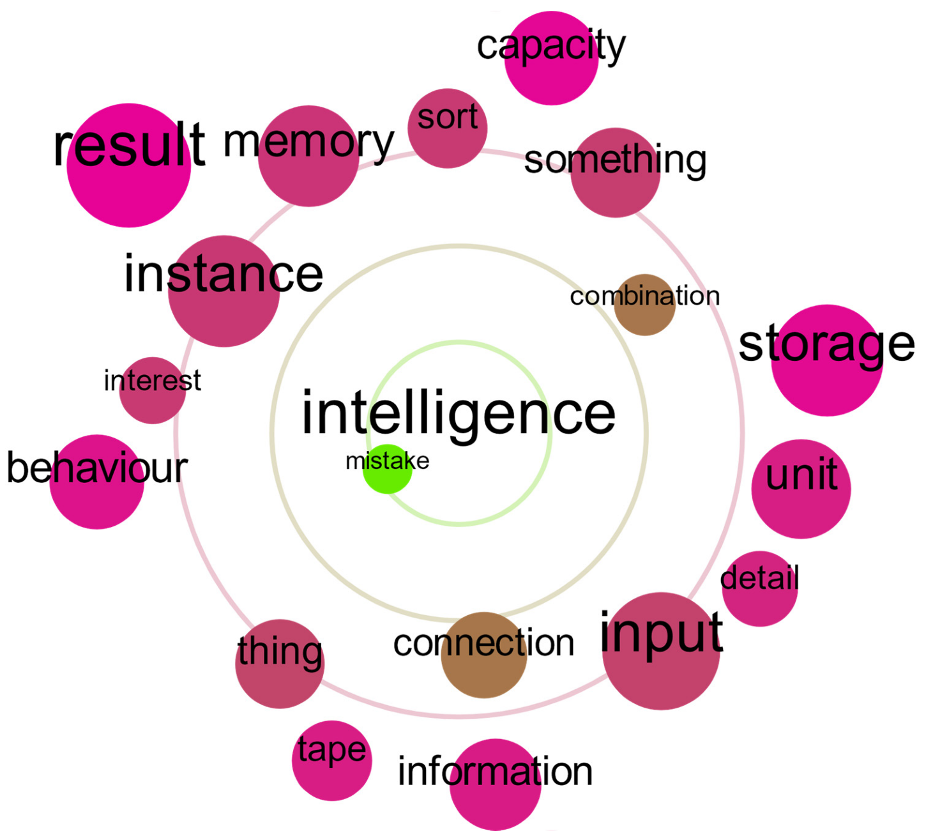
More basic objections to the Turing test
Block’s objection: Text is stored in binary.
Given a large enough database, it’s possible to store a library of queries & plausible answers to mimic intelligence via table lookup.
Do we ascribe intelligence to such a system?

Slide 11
Strong v. Weak AI
One school of thought (dominated by MIT) argues that any system demonstrating intelligent behavior is AI, regardless of how it achieves its end. This is weak AI.
Another (dominated by Carnegie-Mellon) holds that a system should be based on the same methods of learning & cognition used by humans. This is strong AI.
Weak AI proponents argue that the purpose of AI is to solve difficult problems
if we obtain a solution, we are more concerned with the correctness & generalizability of that solution
If the process used to obtain it is different than a human would use, who cares?
Strong AI proponents argue that the end goal is “true” intelligence, which would require self-awareness (consciousness)
To date, there is no general-purpose strong AI in existence. All systems in existence today are weak AI, and often very limited
However, a system that can read MRI scans and diagnose cancers as well as an experienced radiologist, and nothing else, is still very useful

Slide 12
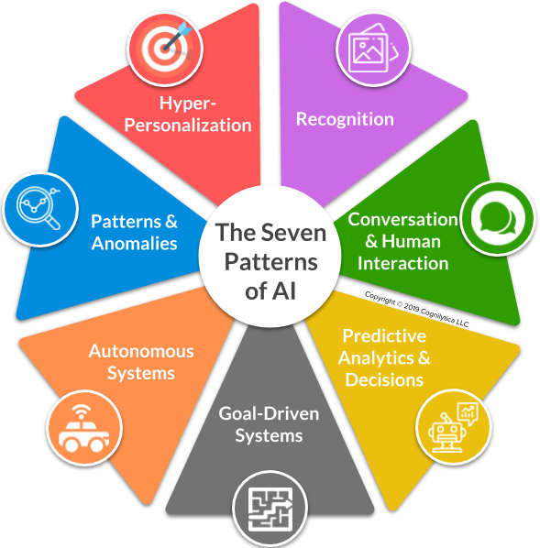
Common Implementations

Slide 13
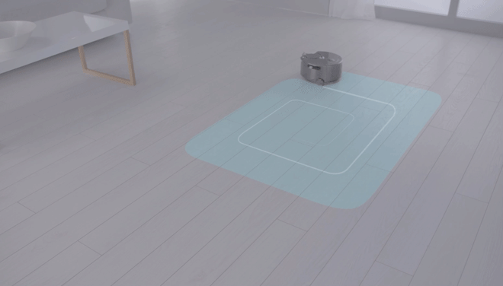
Agents, Environments, and Perception
Agent: Anything that can be viewed as perceiving its environment through sensors and acting on that environment through actuators.
Percept: The agent’s perceptual input at a given instant
Percept sequence: Complete history of percepts
Choice of action can depend on percept or percept sequence, but not on anything it has not observed yet.
Agent’s behavior is described by an agent function that maps percepts or percept sequence to actions
Note that agent function does not base its actions on the environmental state, only on what has been perceived about that state
An agent function is implemented by an agent program.
Conceptually can be viewed as a table lookup or set of if-then rules; most implementations are more complex
Vacuum cleaner world: 2 squares, A & B, each can be clean or dirty. Actions are GO LEFT, GO RIGHT, CLEAN
Can build up table: given this percept (or sequence), do this

Slide 14
What makes an agent ‘rational’?
One definition is that a rational agent does the right thing—with the proper “then” action for every “if” state
But what does “doing the right thing” mean?
We consider consequences.
The right action is the one that leads to the desired outcome based on the series of environmental states produced by interacting with the environment
Not agent states; otherwise our agent can delude itself by simply defining whatever it does (even if random) as the ‘correct’ thing to do
Compare the tendency among humans to tell themselves they don’t really want something that’s out of reach anyway (sour grapes)
Agent function/program should be designed according to circumstances
For example, our vacuum cleaner should get credit for cleaning up dirt
But be careful! A vacuum could clean up some dirt, get credit, dump the dirt onto the floor, clean it up, get credit, dump it, clean it up, get credit…
Probably better to design it based on state of square (clean or dirty), perhaps with penalty for electricity use or noise, to discourage unnecessary work
In general, it’s better to define the goal state in terms of what is actually wanted, not on how the agent should behave.
Still issues to work out, based on how we reward cleanliness
Mediocre, kinda-sorta clean all the time?
Or immaculate as soon as it’s done, at the cost of long breaks (and therefore dirt buildup) between cleanings?

Slide 15
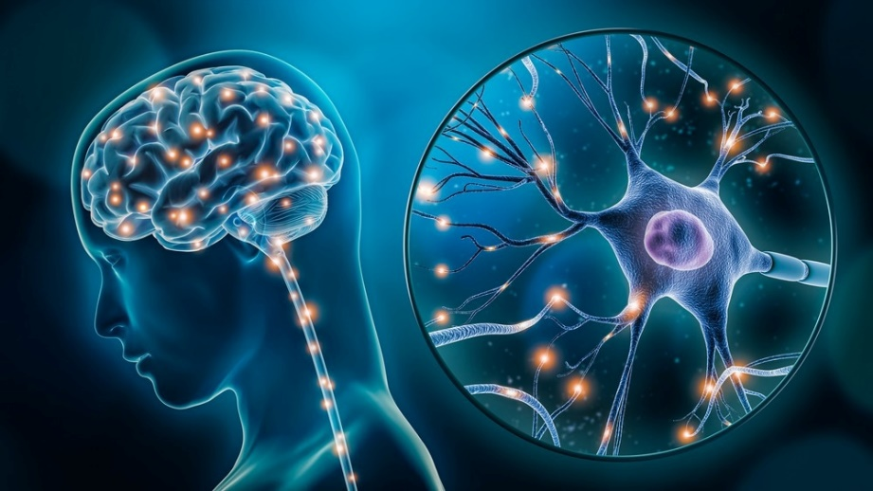
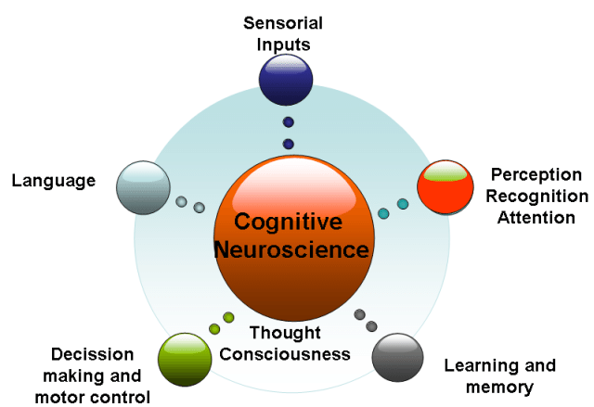
Foundations of AI
Neuroscience
How do brains process information?
Brains are MUCH more energy efficient than any CPU
Psychology
How do humans and animals think and act?
Computer Engineering
How can we build an efficient computer?
Control Theory & Cybernetics
How can artifacts operate under their own control?
Homeostasis, objective function
Linguistics
How does language relate to thought?

Slide 16
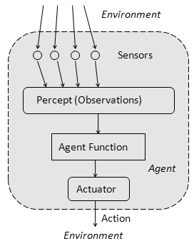
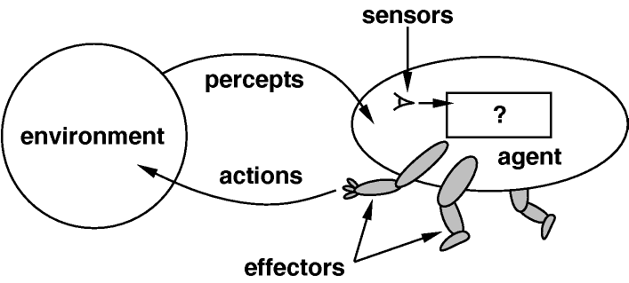
Define “rational.”
Rationality depends on:
The performance measure that defines success
The agent’s knowledge of the environment
The actions the agent can perform
The agent’s percept sequence
For each possible percept sequence, a rational agent should select an action that is expected to maximize its performance measure, given the evidence provided by the percept sequence and whatever built-in knowledge the agent has

Slide 17
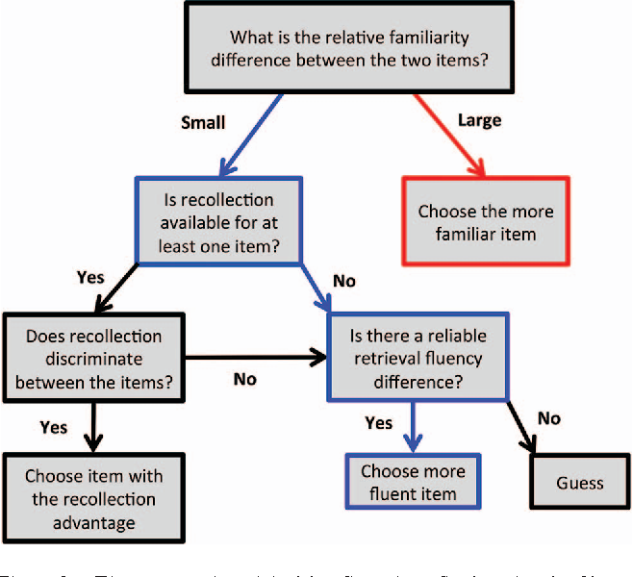
Heuristics
AI often relies on applying heuristics (which usually get a correct answer, at least approximately, and do it quickly) rather than algorithms (which always get a correct answer, exactly, eventually)
Solving a simpler but related problem
Working backward from a solution toward the starting state
Identifying similar solved problems & testing those solutions
Successive approximation (iteration)—if we can’t find a solution, can we find a state that is in some way “closer”?
And if not, what do we do?

Slide 18
Problems suitable for AI
Most AI problems are large
Cannot be solved by straightforward algorithms
Embody (encapsulate / integrate) a large amount of human expertise [representation]
Examples:
Medical diagnosis (one of the first applications of expert systems)
A lot of expertise, much of it in the form of if-then rules in a roughly hierarchical structure
Very complex, with complex interactions between rules & possible causes
Given a user’s shopping history, what specials are likely to lure them into the store in the next week?
Given all of our shoppers’ histories, what specials would bring the most total business in to the store?
Given this user’s travel history, how much are they likely willing to pay for this airline ticket right now?
Given a user’s spending history, what changes to their budget would we recommend? (“Do you really need to eat out quite so often?”)
Given that chess has about 10⁴² “reasonable” games and about 10¹²⁰ possible states, can we make a program that plays chess “well”?
How well?
With perfect play by both sides, who wins?
What is the best move in a particular position?
Note that this is still weak AI—a strong AI system could not only beat the very best humans, it could also explain the reasoning behind its moves and identify how to teach others to play better

Slide 19
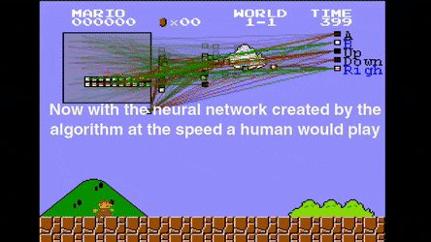
Properties of Task Environments
Fully v. Partially Observable
Can sensors detect all aspects of environment relevant to the choice of action?
May only be partially observable due to noise, distance, or inaccessibility (robot taxi can’t tell what other drivers are thinking)
If there are no sensors at all the environment is unobservable
All is not lost, we can still behave rationally, and make certain deductions about our environment, without sensors

Slide 20
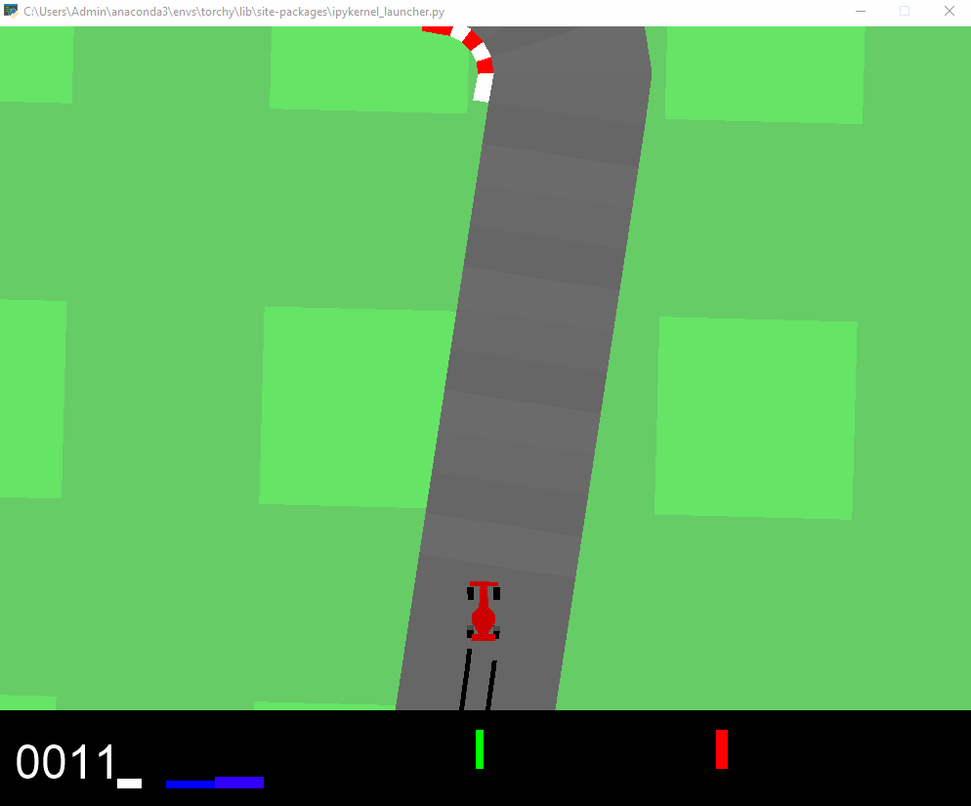
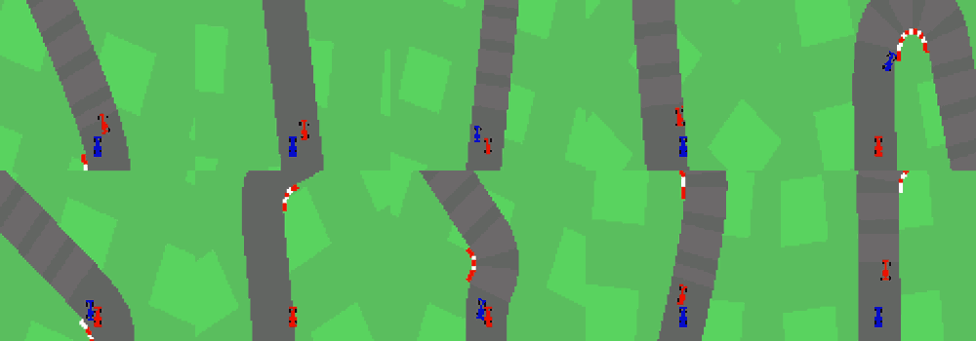
Properties of Task Environments
Single Agent v. Multiagent
Is there more than one agent active in the environment?
Do we classify other drivers as agents, or semi-random features of the environment?
Is the other agent best described by assuming it’s trying to maximize its own performance measure?
Are other agents cooperative or competitive?
Chess is competitive
Taxi-driving is partially both; vehicles cooperate to avoid collision, compete for limited parking spaces
Communication & cooperation emerge as rational strategies in cooperative environments; randomized behavior avoids predictability in competitive environments

Slide 21
Properties of Task Environments
Deterministic v Stochastic
Is the environment’s next (or immediate future) state completely determined by the current state (or state history) and the action executed by the agent?
Ignore the uncertainty from the actions of other agents; we deal with that elsewhere
Note that a fully deterministic but only partially observable environment might seem stochastic
Tires blow out; traffic can’t be predicted exactly
Environments not fully observable or not deterministic are uncertain.
“Deterministic” implies we know something about the probabilities of possible outcomes. If we only know possible outcomes but not their probabilities, the situation is nondeterministic.
These agents usually have performance measures requiring success for all possible outcomes of its actions

Slide 22
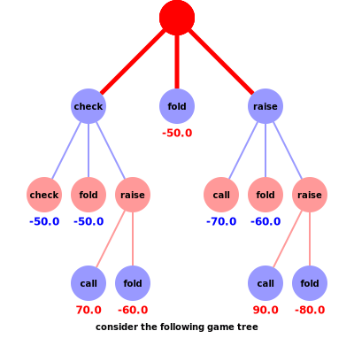
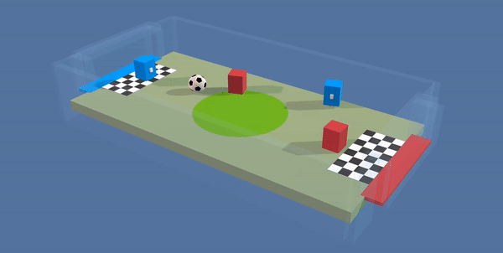
Properties of Task Environments
Episodic v. Sequential
Does the agent need to remember the history of previous
states, or just attend to the current one?
Can this decision affect future ones?
Winning or losing this hand of poker doesn’t affect the next hand
If the same position occurs 3 times in a game of chess, the game is a draw; thus our agent must remember the sequence of prior positions
Episodic environments usually much easier to deal with

Slide 23
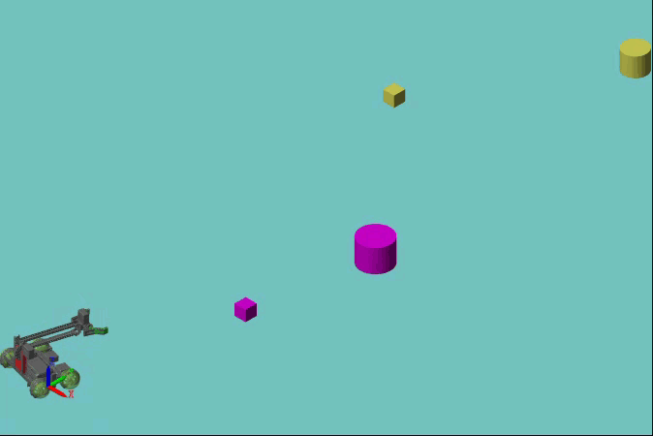
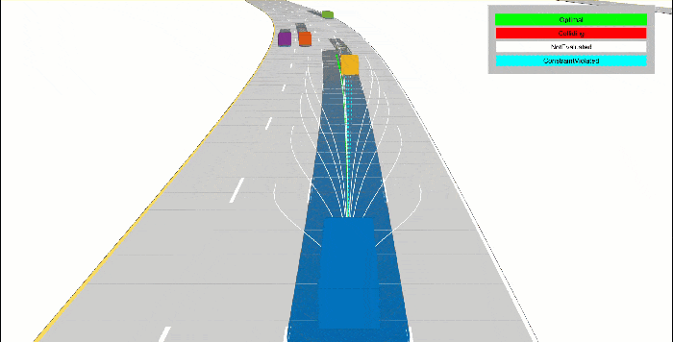
Properties of Task Environments
Static v. Dynamic
Does the environment change while the agent is deliberating?
If yes, and an agent takes too long to decide, it counts as a decision to do nothing
If the environment doesn’t change with time but the performance score does, the environment is semidynamic
Taxi driving is dynamic
Chess (played under tournament time-limit rules) is semidynamic
Sudoku is static
Discrete v. Continuous
How are state and time handled? Discrete steps, or a continuous flow?
Some sensors discretize a continuous property; some input is technically discrete but treated as continuous (e.g. digital video)
Known v. Unknown
The agent’s (or designers’) knowledge about the ‘laws of physics’ related to a task.
In a known environment, the outcomes (or their probabilities) of all actions are known.
An unknown environment must be explored, or actions tried, to see what effect they have
A known environment can still be partially observable
A card-playing agent can’t see other players’ hands, but knows what game it’s playing

Slide 24
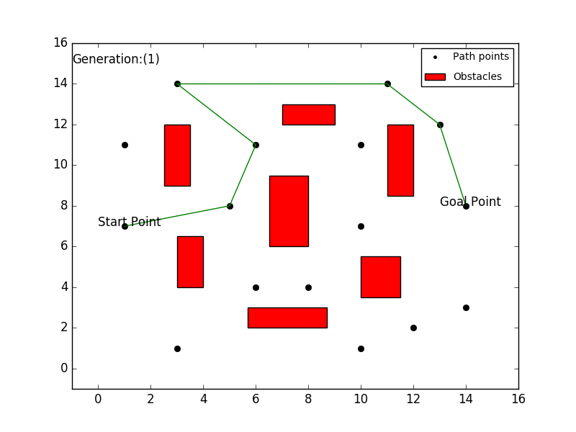
Environments
Most challenging cases:
partially observable
multiagent
stochastic
sequential
dynamic
Continuous
unknown
Driving a rental car in a new country with unfamiliar geography and traffic laws can be… interesting.
Some environments can be classified multiple ways depending on how we define the boundaries of the problem
Is medical diagnosis single agent, or does the agent also have to deal with medical staff?
Is it single episode or sequential? (Can it propose a series of tests to refine the diagnosis? Review prior medical history from previous episodes?)

Slide 25
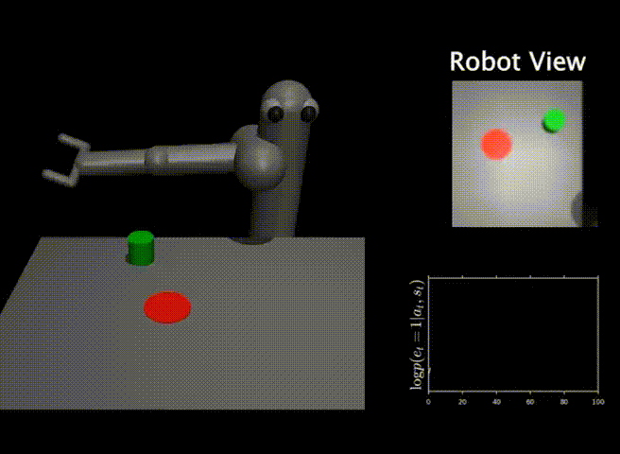
Foundations of AI
Philosophy
Can formal rules be used to draw valid conclusions?
Rationalism
How does a mind arise from a physical brain?
Dualism (mind/body problem) v. Materialism (the body is the mind)
Where does knowledge come from?
How do we know what we know (epistemology)?
How does knowledge lead to action?
Mathematics
What are the formal rules used to draw valid conclusions?
What can be computed?
Godel’s Incompleteness Theorem
Halting problem
Tractability
How do we reason with uncertain information?
Economics
How should we make decisions to maximize payoff?
Decision theory
How should we do this when others may not go along?
Game theory
How should we do this when the payoff may be far in the future?
Operations research, Markov processes

Slide 26
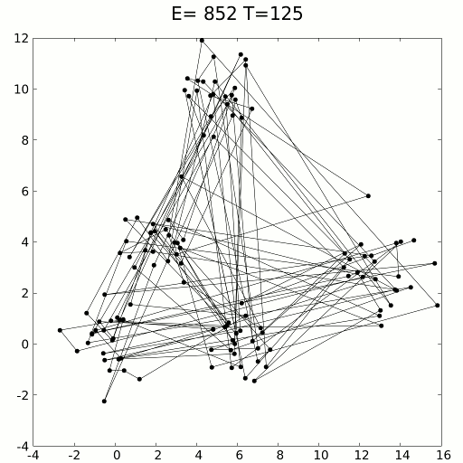
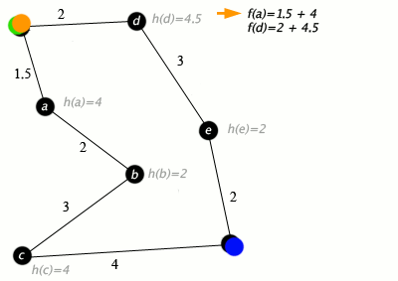

(Not covered in class) Looking Forward: Methods/techniques of AI
Search algorithms
Unguided (blind)
Depth-first
Breadth-first
Guided (heuristic)
Hill-climbing
Beam search
Best first
Branch and bound
Two-person games
Adversarial search
Iterated prisoner’s dilemma
Automated reasoning
Requires knowledge representation system, and inference engine
Production rules & expert systems
Cellular automata (complex behavior from simple rules, e.g. Conway’s Game of Life)
Neural Computation
Genetic & Evolutionary computation
Probabilistic & Fuzzy Reasoning

Slide 27
(Optional)Additional Readings
Turing, Computing Machinery and Intelligence
http://phil415.pbworks.com/f/TuringComputing.pdf
Esp. Turing’s treatment of various objections to AI, p. 443 & following
Video - Crash Course Philosophy: AI and Personhood
https://www.youtube.com/watch?v=39EdqUbj92U&index=23&list=PL8dPuuaLjXtNgK6MZucdYldNkMybYIHKR

